Slide 1
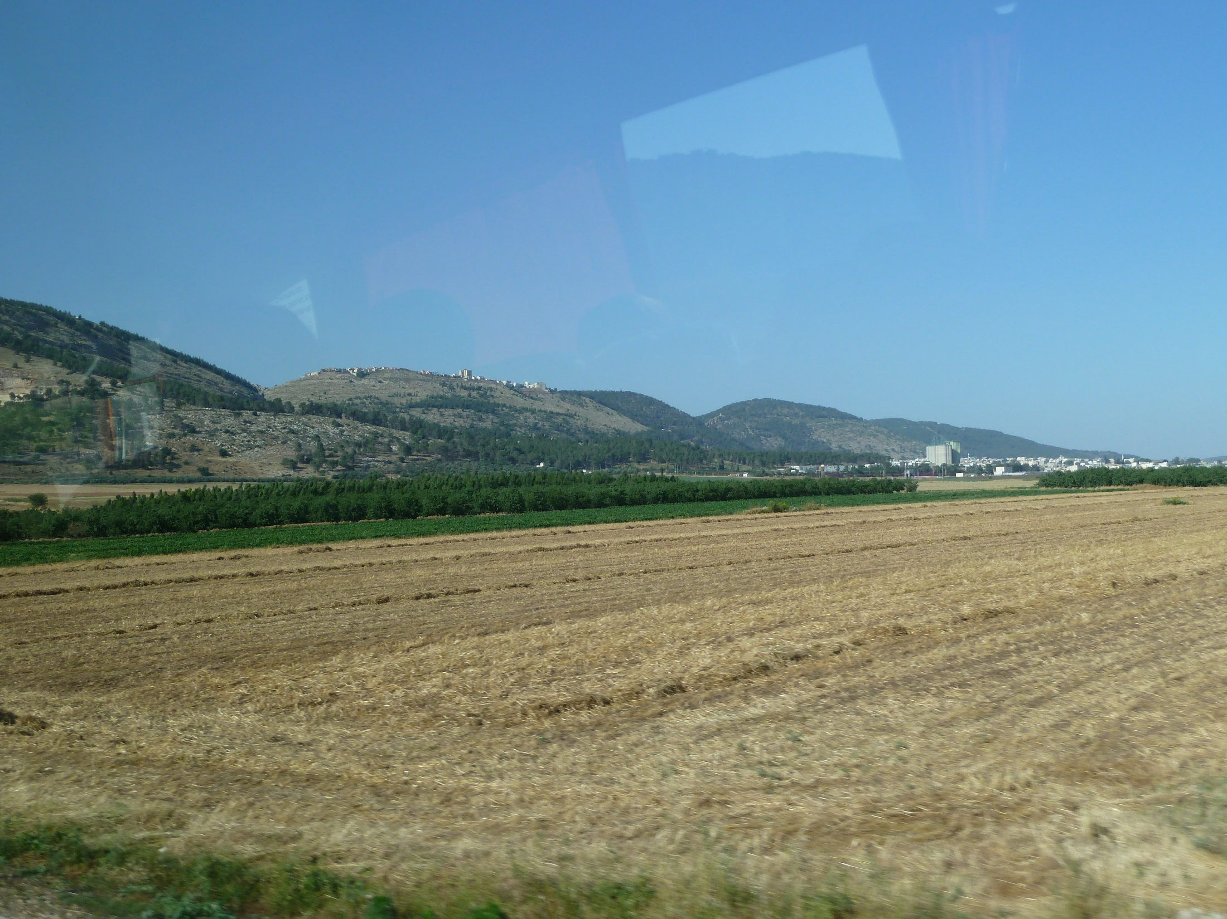
View of the Nazareth Ridge in Galilee
from the Jezreel Valley to the south
John 4.43-54

Slide 2
John 4.43-45 [NET]: After the two days [with the Samaritans] he [Jesus] departed from there to Galilee. (For Jesus himself had testified that a prophet has no honor in his own country.) So when he came to Galilee, the Galileans welcomed him because they had seen all the things he had done in Jerusalem at the feast (for they themselves had gone to the feast).

Slide 3
John 4.45 [ESV]: … the Galileans welcomed him, having seen all that he had done…
John 4.45 [NET]: … the Galileans welcomed him because they had seen all the things he had done…
John 4.45 [NIV]: … the Galileans welcomed him. They had seen all that he had done…

Slide 4
John 4.43-45 [NET]: After the two days [with the Samaritans] he [Jesus] departed from there to Galilee. (For Jesus himself had testified that a prophet has no honor in his own country.) So when he came to Galilee, the Galileans welcomed him because they had seen all the things he had done in Jerusalem at the feast (for they themselves had gone to the feast).

Slide 5
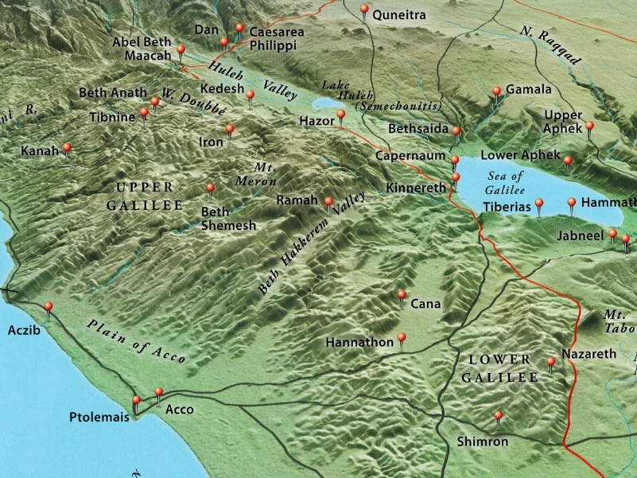
John 4.46-47: Now he came again to Cana in Galilee where he had made the water [into] wine. In Capernaum there was a certain royal official whose son was sick. When he heard that Jesus had come back from Judea to Galilee, he went to him and begged him to come down and heal his son, who was about to die.
Map from Zondervan Bible Atlas

Slide 6
John 4.48: So Jesus said to him, “Unless you people see signs and wonders you will never believe!”

Slide 7
John 4.49-50: “Sir,” the official said to him, “come down before my child dies.” Jesus told him, “Go home; your son will live.” The man believed the word that Jesus spoke to him, and set off for home.

Slide 8
John 4.51-53: While he was on his way down, his slaves met him and told him that his son was going to live. So he asked them the time when his condition began to improve, and they told him, “Yesterday at one o'clock in the afternoon the fever left him.” Then the father realized that it was the very time Jesus had said to him, “Your son will live," and he himself believed along with his entire household.

Slide 9
John 4.54: Jesus did this as his second miraculous sign when he returned from Judea to Galilee.

